Slide 1



Technology Ambassador Program
Introducing Programming Concepts through Scratch
Valentina Mosquera Reina, Matt Bauer, Josiah Williams, Ryan Cunico
Notes:
Hello today we will be covering the Teaching Programming Fundamentals with Candy Catch Workshop, by TAP

Slide 2
TAP
The Technology Ambassadors Program (TAP) was created at Georgia Gwinnett College located in Lawrenceville, GA.
The TAP program addresses the need to increase the number of students who persist in an IT major or IT minor, particularly those underrepresented in computing.
The TAP program at GGC strives to break the misconceptions of the IT field by providing fun workshops for students of all backgrounds. TAP students design engaging and fun outreach workshops to encourage interest in IT and STEM.
Notes:
Tap is the Technology Ambassador program, the was created to bring awareness to the lack of students interested in the IT field. As part of tap we hope to break any misconceptions about the IT field grow interest through a variety of fun and engaging workshops.

Slide 3
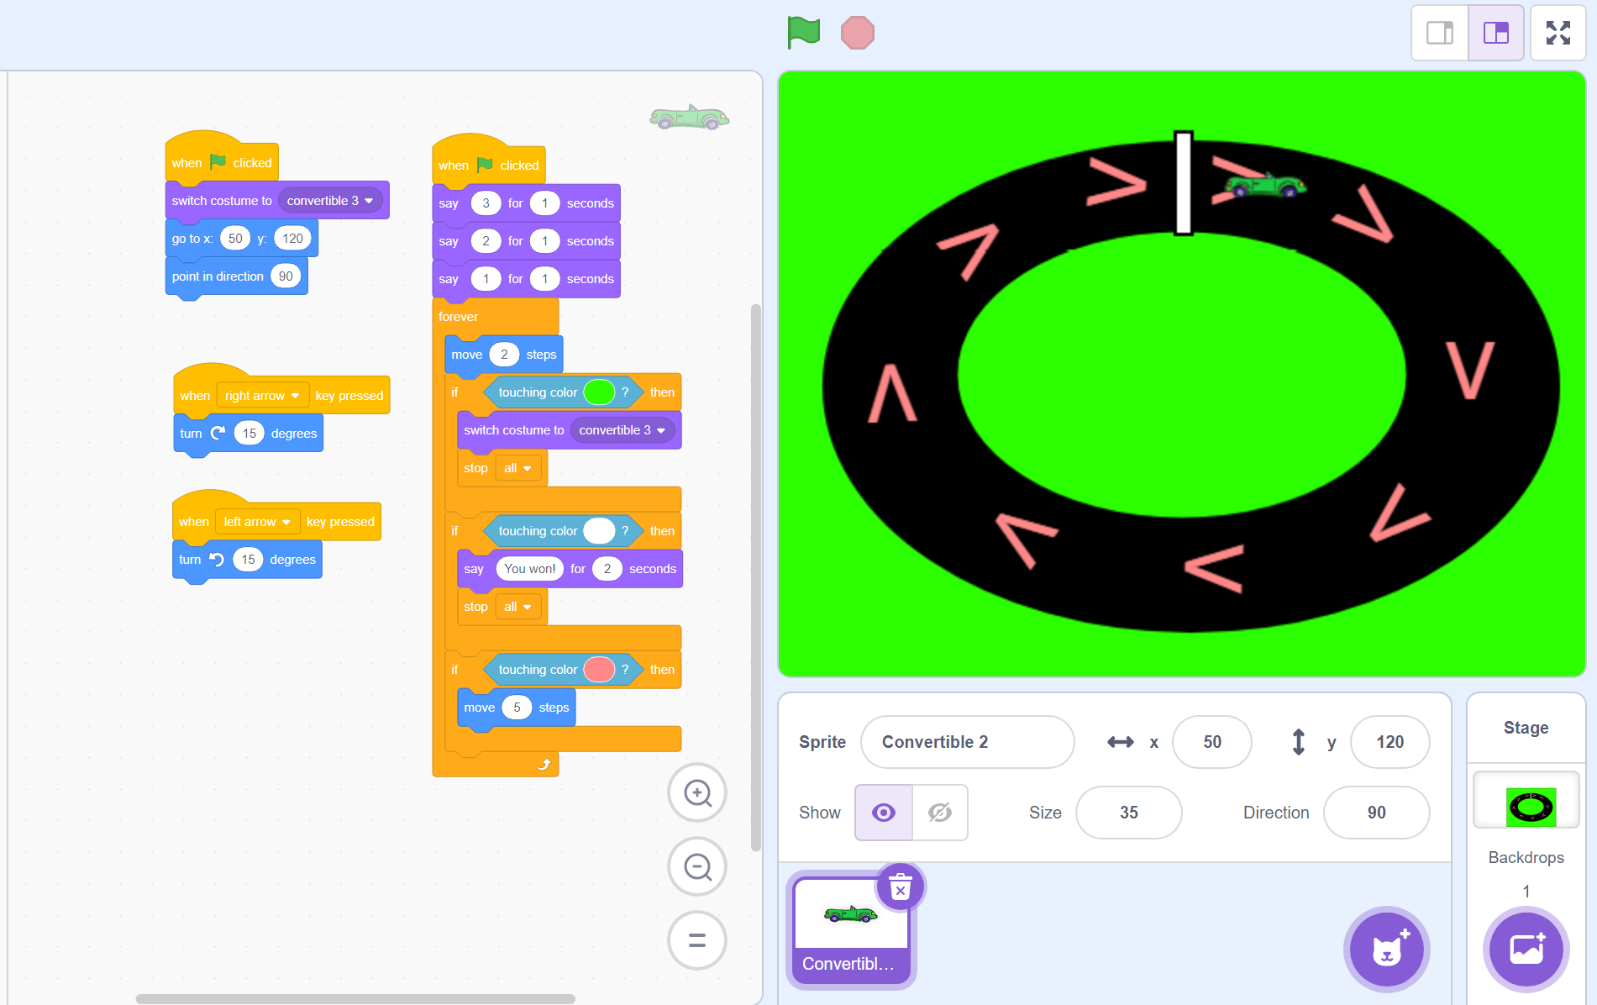
Project Description
Students will code their own basic racing game by following along with visual instructions.
Step-by-step directions (with pictures) will be provided to students in a separate document.

Slide 4

What is Scratch
Scratch is a block-coding based software used to introduce basic coding concepts to beginners through interactive games.

Slide 5
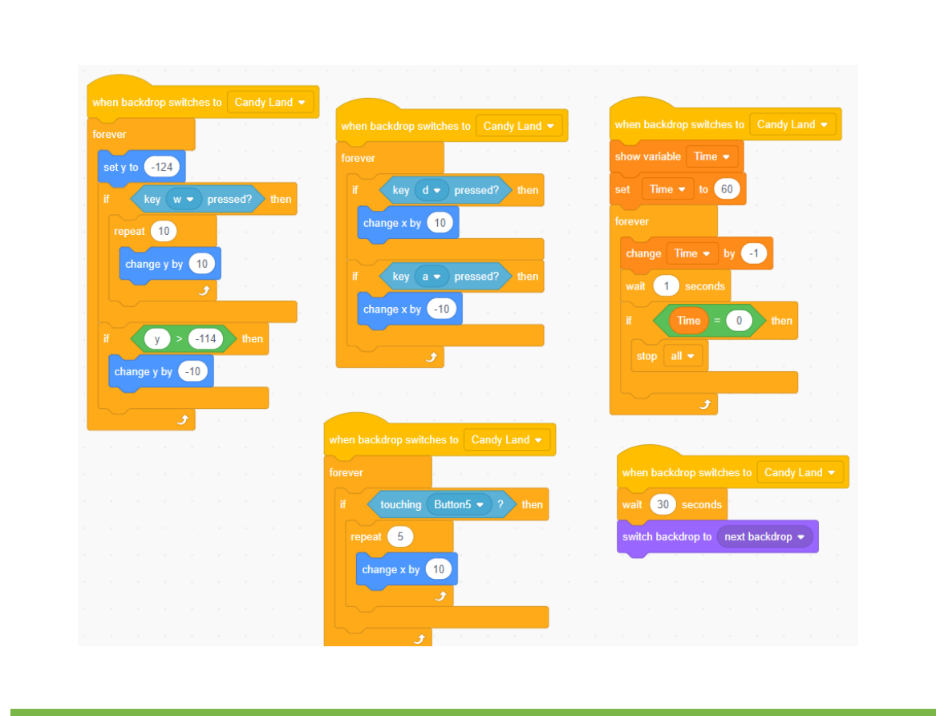
Block Coding
Block Coding utilizes a drag-and-drop learning environment where programmers use blocks to construct basic programs.
Concepts such as if/then statements and while loops are the basis for how these programs are developed.

Slide 6
Programming Concepts
If-Then Statement: An if-then statement is a concept that specifies the execution of an action when a condition is true, or another action is done. Example: “If I wash my hands, then they will be clean.”
While Loop: All the code in the loop will execute forever, as long as the requirements asked are still met.
Example: “While the faucet is open, the water will keep running. The water will keep running until I turn off the faucet”
Students will be exposed to the following using these examples:
”While” loop – corresponds to the “forever” that makes the car move forward
“If” statement – “If” car touches green, stop and change to crashed car
“If” statement – “If” car touches “V” (pink or blue boost) - speed up
“If” statement – “If” car touches finish line (white) – end and display message
Listeners for the right / left arrows (to turn the car)

Slide 7
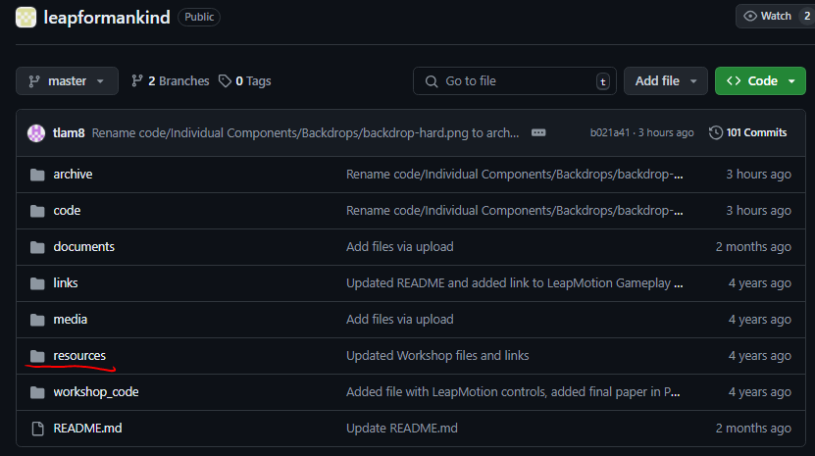
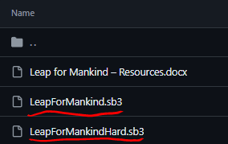
Before we begin…
First thing, head to the Leap For Mankind repository.
Once there make sure to click on the resources tab.
Download the required files:
LeapForMankind.sb3
LeapForMankindHard.sb3
Walkthrough-Steps.docx
Step-by-step of the steps we will be doing in the workshop

Slide 8
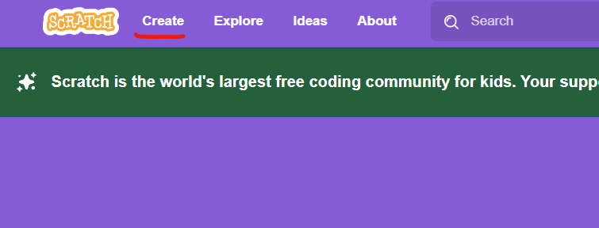
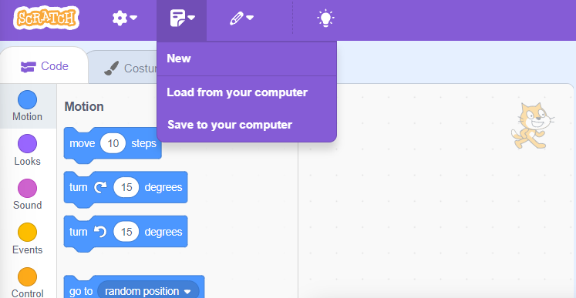
Preparing Scratch
Head to Scratch.mit.edu and click on CREATE on the top left corner.
The page should still look empty but now we have the resources needed to create our own game.
You may load the LeapForMankind.sb3 and Hard version to experience what the game should look like before having them start

Slide 9
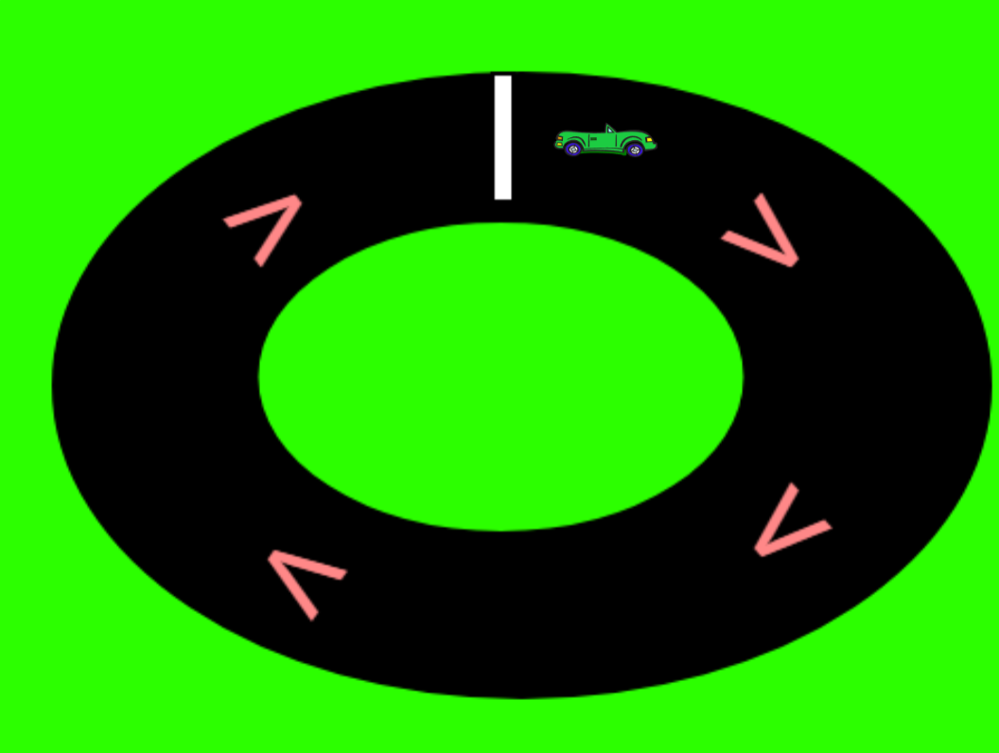
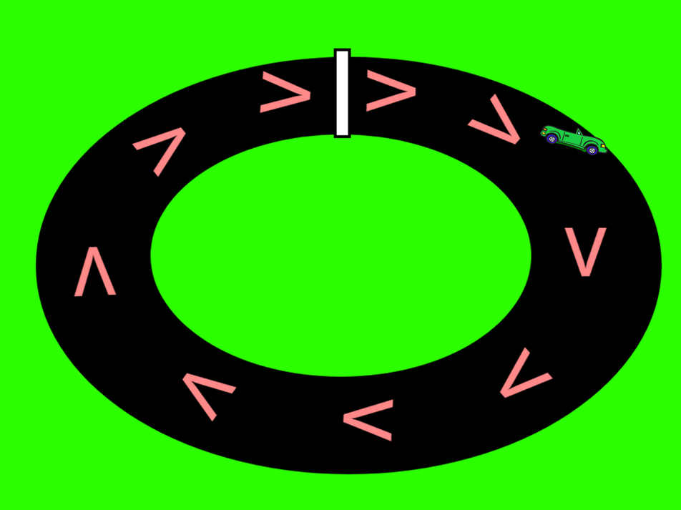
Making the game
Follow the Walkthrough-Steps.docx you downloaded from the repository.
Some issues to look out for include: a thin track, no green border, having the inside and outside track not match colors, Car touching the finish before the game starts, etc.
Notes:
Some of the troubles students my face include: A thin track, no green green border, having the inside and outside track not match colors, Car touching the finish line at the start.

Slide 10
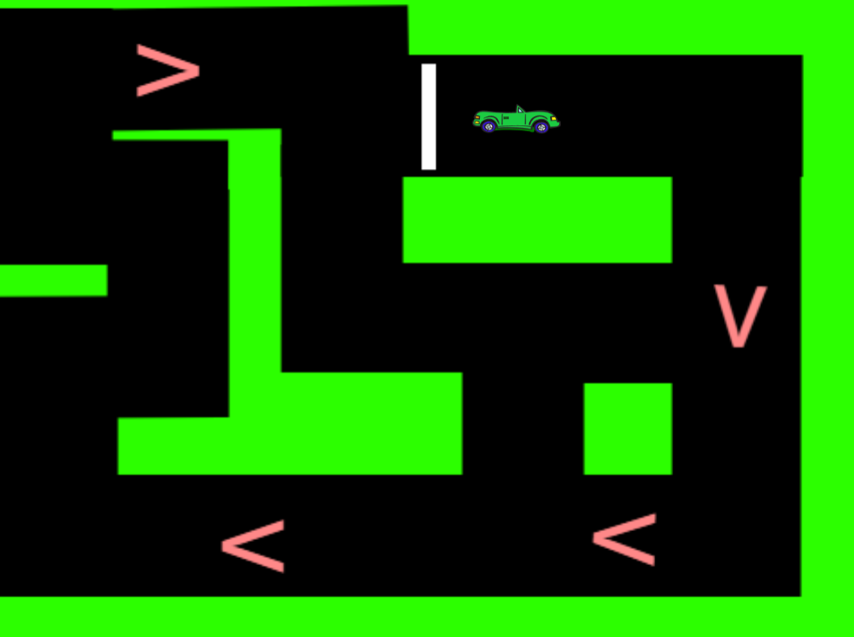
Experiment with your game!!!
From here spend 5-10 minutes playing your game
After that, play with the code:
Change racetrack
Add sprites/models
Change backgrounds
Create more difficult levels

Slide 11
Thank You
Please try out our other projects!!!

